Slide 1
Real Gas Behaviour
Dr. A. M. More
D. B. Science College, Gondia

Slide 2
Real Gas do not obey postulates of an Ideal Gas, the reasons are
1. Molecules of Real gas exerts a force on each other.
2. The volume of molecule is not negligible as compared with volume of the gas.
Hence the Ideal gas equation needs to be corrected for pressure and volume terms.

Slide 3
Van- der Waal’s Equation
Van-der Waal’s equation represents behaviour of real gas for temperature and pressure variation.
Pressure correction
Due to presence of intermolecular force of attraction, actual pressure felt by real gas is more than ideal gas
$P_{real}$= P + $P_{corrected}$
But it is found that
${ P}_{corrected}$ α ${\text{ρ}}^{2}$ α $\frac{1}{V^{2}}$
$P_{corrected}$ = $\frac{a}{V^{2}}$ , where $a$ is pressure correction constant.
${∴P}_{real}$= P + $P_{corrected}$ = P + $\frac{a}{V^{2}}$ ------------- (1)

Slide 4
Volume Correction
Due to finite size of gas molecules, the actual space available space for the movement of the molecule is less than the volume of the vessel.
For the molecule with radius ‘r’ , the molecule have sphere of influence have radius equal to ‘2r’
Let volume of sphere of molecule be ‘x’
$$x= \frac{4}{3}πr^{3}$$
Volume of sphere of influence of radius ‘2r’ is
$s= \frac{4}{3}π{ (2r)}^{3}$= 8 x $\frac{4}{3}πr^{3}$= 8 $x$
$V_{real}$= V + $V_{corrected}$
$V_{real}$= V - $8 s$ ---------------- (2)

Slide 5
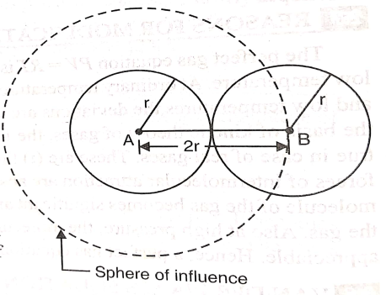
The volume available for n^{th} molecule
= V- (n-1) s
$$∴Average space available for each moelcule=\frac{V+\left(V−s\right)+\left(V−2s\right)+…….+[V−\left(n−1\right)s]}{n}$$
$$=V−\frac{s}{n} \frac{n\left(n−1\right)}{2}$$
$=V−\frac{ns}{n}+\frac{s}{2}$
Due to large number of gas molecules, $\frac{s}{2}$ is neglected.
$∴Average space available for each moelcule$=$V−\frac{ns}{2}$
=$V−\frac{n(8 x)}{2}$
= $V−4nx$
= $V−b$, where b is volume correction constant
$$∴Average space available for each moelcule$$
= $V_{corrected}$= $V−b$ …….(3)

Slide 6
Therefore new equation of state for real gas is
$P_{real} V_{real}$= RT
$∴$ (P + $\frac{a}{V^{2}}$ ) $(V−b)$= RT ………. (4)
Above equation gives the behaviour of real gases under the variation of pressure and temperature, which is known as Van der Waal’s equation.

Slide 7
Critical Constant’s
The maximum temperature below which the gas can be liquified by varying pressure of the gas alone is known as Critical Temperature (Tc).
Pc and Vc represents Critical Pressure and Critical volume respectively corresponding to liquification of gas at critical temperature (Tc).
Numerically Tc, Pc, Vc are constant for a gas.
Critical point on the isotherm is that point corresponding to critical temperature at which change of the state from gaseous to liquid occurs at constant Pc and Vc.
Limitations of Critical Constants
1. The values of ‘a’ and ‘b’ are not constant. ‘a’ found to be temperature dependant.
2. According to theory, Vc=3b but it is found to depend on nature of the gas and practically Vc≈2b.
3. Theoretical value of critical coefficient ($\frac{R Tc}{Pc Vc})$is 2.67for all gases but it varies for gases. The average value of Critical Coefficient is 3.7 for most of the gases.

