Slide 1
B.Sc. II Semester IV
Paper II
Applied Microbiology
Unit I ---Water microbiology
Significance of bacteriological analysis of water, collection and handling of water samples, indicators of excretal pollution, bacteriological analysis of water for coliforms and faecal streptococci (MTFT, MFT), water treatment using SSF and RSF, methods of chlorination, differences between fecal and non fecal organisms
Unit II---Waste water treatment
Sewage types, composition, physical, chemical and biological characteristics, BOD, COD, ThOD, trickling filter, activated sludge, RBC, sludg digester, oxidation pond, septic tank, imhoff tank
Unit III--- Air and Soil microbiology
Microbial analysis of air , settling plate and Anderson technique, bacteria and fungi as biopesticides, biofertilizers, PSB, mycorrhiza, microbial leaching of copper and uranium
Unit IV --- Food microbiology
Food spoilage organisms, canning process, pasteurization, low temperature preservation, chemical preservation
Food borne diseases and food intoxication

Slide 2
Coliforms
The coliform group includes E. coli, Enterobacter aerogenes, and Klebsiella pneumoniae.
Coliforms are defined as
facultatively anaerobic,
gram-negative, nonsporing,
rod-shaped bacteria
that ferment lactose with gas formation within 48 hours at 37°C.

Slide 3
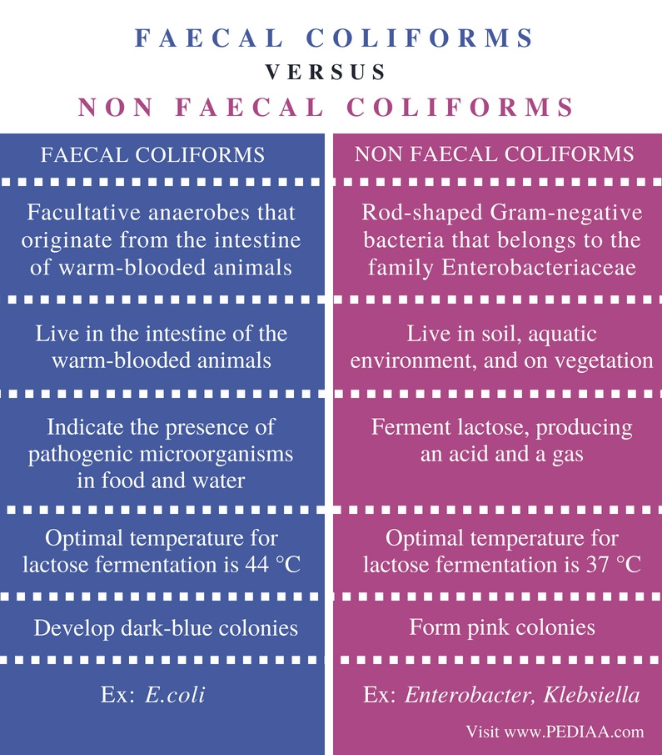

Slide 4
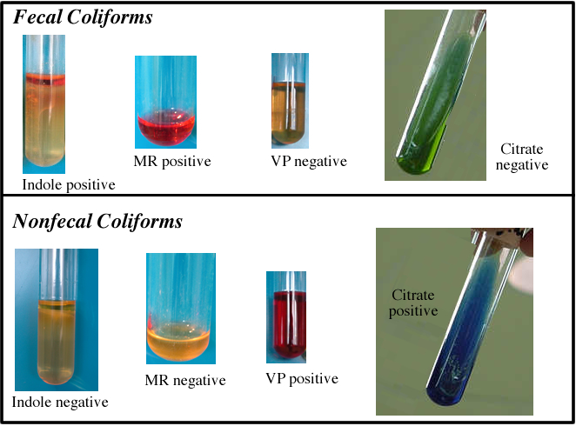

Slide 5
Bacteriological Analysis of Water (Tests for Coliforms)
Multiple Tube Fermentation Technique
Or
Multiple Tube Dilution Technique
Or
MPN Technique (If only first test is performed )

Slide 6
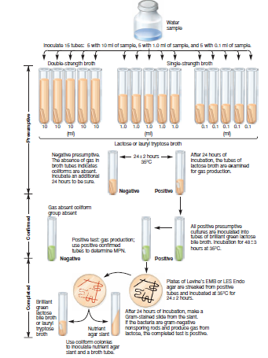

Slide 7
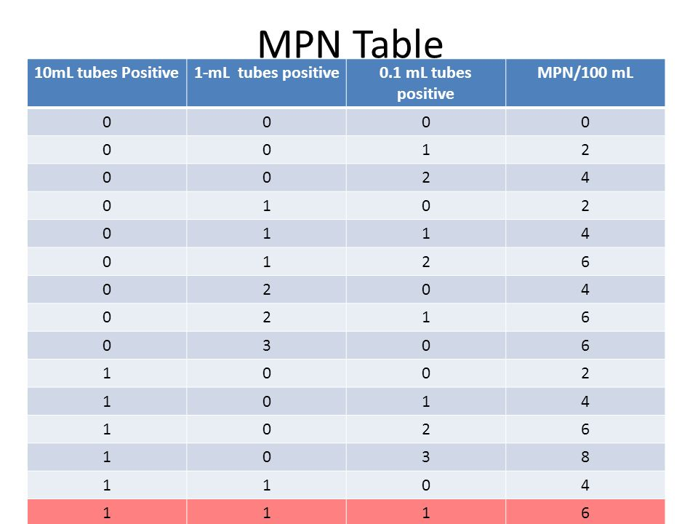

Slide 8
Membrane Filtration Technique
Alternative to MPN or MTFT
use by government labs for monitoring drinking water,
used for microbial monitoring in the pharmaceutical, cosmetics, electronics, and food and beverage industries
Less time required

Slide 9
Membrane Filter
Made of cellulose acetate or Nylon,6,6.
0.45 micro m
47 mm in diameter

Slide 10
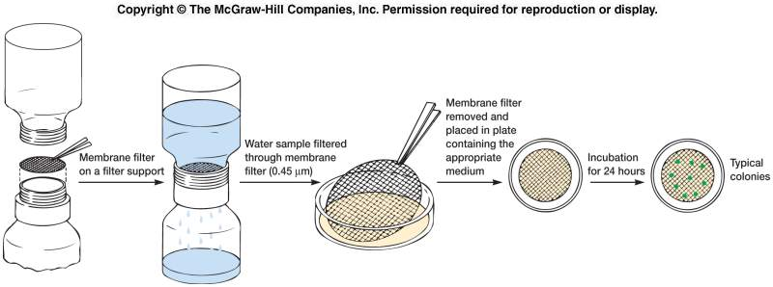

Slide 11
Total coliform /100 ml = coliform colonies counted X 100/ ml of sample filtered

Slide 12
Tests for faecal Streptococci
Streptococcus faecalis
Streptococcus bovis
Persist for longer than coliform
Resistant to drying

Slide 13
MTFT for Faecal Streptococci
Presumptive Test
15 test tubes with Azide Dextrose broth
Incubate at 37⁰C for 24 - 48hrs
Test for turbidity
Confirmed Test
All positive presumptive tubes are streaked on Esculin Azide Agar or Pfizer Selective Enterococcus Agar
Incubate at 37⁰C for 24hrs
Brownish black colonies with brown halos
Refer to MPN for result

Slide 14
MFT for Faecal streptococci
K-Streptococcus or M-Enterococcus agar
Dark red to pink colonies
Slanitz & Barley’s Medium
Red or maroon colonies

